Slide 1
Capstone Project - The Battle of Neighbourhoods
Final Report
Living in Toronto after quarantine days.
by Muharrem Sener Yuce
April / 2020

Slide 2
Capstone Project - The Battle of Neighbourhoods
Final Report
Toronto:
Toronto demographics show that it is a large and ethnically diverse metropolis.
With around half of its population born outside the country, Toronto is often referred to as 'the most multicultural city in the world.
Toronto boasts 200 ethnic groups with over 140 languages spoken.

Slide 3
Capstone Project - The Battle of Neighbourhoods
Final Report
Covid-19,
Pandemic
The complicated problem for World.

Slide 4
Capstone Project - The Battle of Neighbourhoods
Final Report
Covid-19 caused,
People were caught unprepared for this rapidly spreading problem. Losses are increasing rapidly. People have to live in quarantine. This negatively affects the psychology of people in cities with social and economic life.

Slide 5
Capstone Project - The Battle of Neighbourhoods
Final Report
At the end of these difficult days, it is predicted that people will prefer to stay away from crowded places to maintain social distance. Activity venues that give people the chance to maintain this social distance will be preferred. One of the most suitable activities that provides the conditions suitable for this prediction is Yoga Studios.

Slide 6
Capstone Project - The Battle of Neighbourhoods
Final Report
Question (for Toronto local) :
In which area is it appropriate to open a Yoga Studio in Toronto?
Who would be interested in this project?:
by Governments, Municipalities, Entrepreneurs to all age citizens and customers.

Slide 7
Capstone Project - The Battle of Neighbourhoods
Final Report
II - Data
For this project we need the following data:
Toronto data that contains list Boroughs, Neighborhoods along with their latitude and longitude.
Data source : https://en.wikipedia.org/wiki/List_of_postal_codes_of_Canada:_M
Description : This data set contains the required information. And we will use this data set to explore various neighborhoods of Toronto

Slide 8
Capstone Project - The Battle of Neighbourhoods
Final Report
Yoga Studios in each neighborhood of Toronto.
Data source : Foursquare API
Description : By using this API we will get all the venues in each neighborhood. We can filter these venues to get only Yoga Studios.
GeoSpace data
Data source : http://cocl.us/Geospatial_data
Description : By using this geo space data we will get the Toronto Borough boundaries that will help us visualization.

Slide 9
Capstone Project - The Battle of Neighbourhoods
Final Report
III – Methodology
The list of neighborhoods in Toronto, Canada preparing by extracting the list of neighborhoods from
Wikipedia: https://en.wikipedia.org/wiki/List_of_postal_codes_of_Canada:_M
The web scraping realized by utilizing the pandas HTML table scraping method.
This is given to us only a list of neighborhood names and postal codes.
For their coordinates to utilize Foursquare to pull the list of venues near these neighborhoods.
To get the coordinates, used CSV file provided by IBM team to match the coordinates of Toronto neighborhoods.
http://cocl.us/Geospatial_data.

Slide 10
Capstone Project - The Battle of Neighbourhoods
Final Report
Coordinates gathered.
Visualizing the map of Toronto used the Folium package to verify whether these are correct coordinates.
Foursquare API to pull the list of top 100 venues within 500 meters radius.
The data pulled the names, categories, latitude, and longitude of the venues.
Checked how many unique categories that we can get from these venues.
Analyzed each neighborhood by grouping the rows by neighborhood and taking the mean on the frequency of occurrence of each venue category.
Here, for made a justification to specifically look for “Yoga Studio”.

Slide 11
Capstone Project - The Battle of Neighbourhoods
Final Report
Performed the clustering method by using k-means clustering.
K-means clustering algorithm identifies k number of centroids, and then allocates every data point to the nearest cluster while keeping the centroids as small as possible.
It is one of the simplest and popular unsupervised machine learning algorithms and it is highly suited for this project as well.
Clustered the neighborhoods in Toronto into 3 clusters based on their frequency of occurrence for “Yoga Studio".
Based on the results (the concentration of clusters), for will be able to recommend the ideal location to open the restaurant.

Slide 12
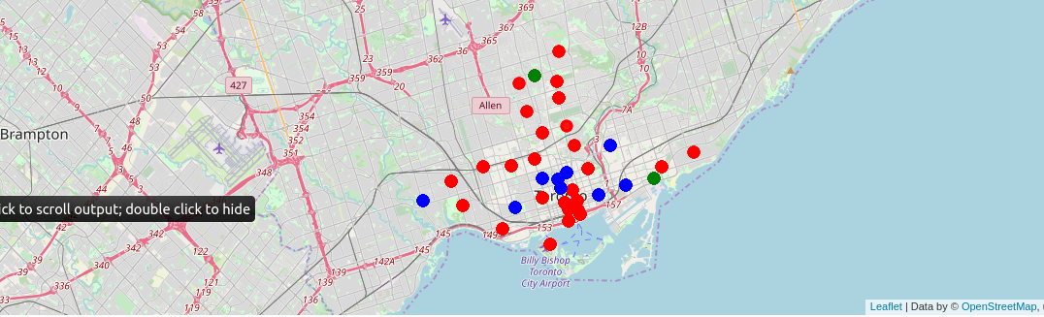
Capstone Project - The Battle of Neighbourhoods
Final Report

Slide 13
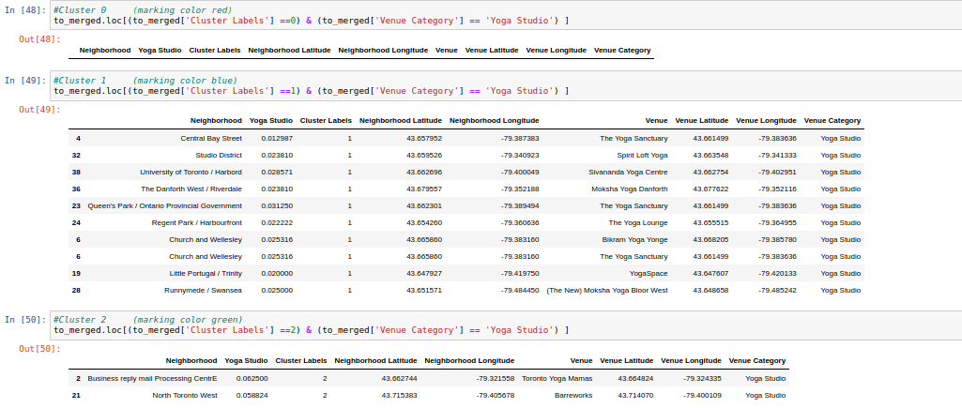
Capstone Project - The Battle of Neighbourhoods
Final Report

Slide 14
Capstone Project - The Battle of Neighbourhoods
Final Report
IV - Result
This study was completed on April 4, 2020.
According to this date, there are yoga studios in the region defined as Cluster 1.
There is no Yoga studio at Cluster 0.
There are only 2 Yoga Studios in the region defined as Cluster 2.
For this reason, more detailed research can be done in the areas defined as Cluster 0 and Cluster 2 for the installation of Yoga studios.

Slide 15
Capstone Project - The Battle of Neighbourhoods
Final Report
V - Discussion
This study is a course study in which 20 hours of working time is envisaged. Made only for the purpose of testing basic research methods and sources of information are limited. In order to make a commercial investment decision on this subject, it is necessary to participate in the analysis in other variables such as rent, transportation convenience.

Slide 16
Capstone Project - The Battle of Neighbourhoods
Final Report
VI- Conclusion
With the Covid 19 outbreak, humanity is going through a huge challenge.
This Covid 19 pandemic; causing irreversible and irreversible losses.
At the end of this period, physical and mental difficulties await us in a world where everything will not be the same anymore.
For this reason, activities such as yoga will be continued and mental meditation activities will increase.
I think that this solution proposal should be taken into consideration by companies and governments as both business investment and social responsibility.

Slide 17
Capstone Project - The Battle of Neighbourhoods
Final Report
P.S.
In the Coursera - Applied Data Science course, many educational work has been done about Toronto. For this reason, the city of Toronto was preferred in this study.
I wish healthy days.

Slide 18
Capstone Project - The Battle of Neighbourhoods
Final Report
Thank you….
For Codes and report
https://github.com/msyuce/-IBM-Applied-Data-Science---Module9---Battle-of-the-Locations
Contact
linkedin.com/in/m-sener-yuce-16433169

